Slide 1
Bank Account System
-Vivi Langaa, Charmi Shah, Laura Gandhi

Slide 2

Functional Requirements
User should be able to sign up account
User should be able to sign in
User should be able to sign out
User should be able to check the current balance available in the account
User should be able to deposit a certain amount
System shall record the change in the balance
User should be able to withdraw a certain amount
System shall record the change in balance
User should be able to check the Transaction History
User should be able to transfer
User should be able to cancel account
User should be able to update information about account
System should be able to show balances
System should record last moment logged in
System should be able to check valid tranasanctions (max limit… etc...)

Slide 3
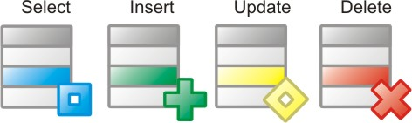
DDL.SQL

Slide 4
Account Database
DROP TABLE IF EXISTS T_ACCOUNT;
CREATE TABLE T_ACCOUNT
(
ACCOUNT_ID INT AUTO_INCREMENT Not Null,
EMAIL VARCHAR(50),
F_NAME VARCHAR(30) NOT NULL,
L_NAME VARCHAR(50) NOT NULL,
USERNAME VARCHAR(50) Not Null,
PASS VARCHAR(50) Not Null,
ACTIVE BOOLEAN DEFAULT TRUE NOT NUll,
CREATED_ON DATETIME DEFAULT CURRENT_TIMESTAMP NOT NULL,
LAST_UPDATE_DATE DATETIME,
PRIMARY KEY(ACCOUNT_ID)
);
Notes:
<number>

Slide 5
Cash Amount Database
DROP TABLE IF EXISTS ACCOUNT_AMOUNT;
CREATE TABLE T_CASH_AMOUNT
(
ACCOUNT_ID INT Not Null,
ACCOUNT_TYPE
AMOUNT BIGINT DEFAULT 0,
LAST_UPDATED timestamp,
PRIMARY KEY (ACCOUNT_ID),
FOREIGN KEY (ACCOUNT_ID) references T_ACCOUNT (ACCOUNT_ID)
ON UPDATE CASCADE
FOREIGN KEY (ACCOUNT_TYPE) references T_CODES (CODE_ID)
ON UPDATE CASCADE
);
Notes:
<number>

Slide 6
Codes for Transfer, Deposit... Database
DROP TABLE IF EXISTS T_CODES;
CREATE TABLE T_CODES
(
CODE_ID INT AUTO_INCREMENT Not Null,
CODE_TYPE VARCHAR(10) Not Null,
CODE_DESC VARCHAR(1000) Not Null,
CREATED_ON DATETIME DEFAULT CURRENT_TIMESTAMP NOT NULL,
PRIMARY KEY(CODE_ID)
);
Notes:
<number>

Slide 7
Transanction History Database
DROP TABLE IF EXISTS T_TRANSACTION_HISTORY;
CREATE TABLE T_TRANSACTION_HISTORY
(
ACCOUNT_ID INT Not Null,
TRANSACTION_TYPE INT NOT NULL,
ACCOUNT_TYPE INT NOT NULL,
AMOUNT bigint,
TRANSACTION_DATE DATETIME DEFAULT CURRENT_TIMESTAMP NOT NULL,
PRIMARY KEY (ACCOUNT_ID, TRANSACTION_DATE),
FOREIGN KEY (TRANSACTION_TYPE) references T_CODES (CODE_ID)
ON UPDATE CASCADE,
FOREIGN KEY (ACCOUNT_TYPE) references T_CODES (CODE_ID)
ON UPDATE CASCADE,
FOREIGN KEY (ACCOUNT_ID) references T_ACCOUNT (ACCOUNT_ID)
ON UPDATE CASCADE
);
Notes:
DROP TABLE IF EXISTS T_TRANSANCTION_HISTORY;
CREATE TABLE T_TRANSANCTION_HISTORY
(
ACCOUNT_ID INT Not Null,
TRANSANCTION_TYPE INT NOT NULL,
ACCOUNT_TYPE INT NOT NULL,
AMOUNT bigint NOT NULL,
TRANSANCTION_DATE DATETIME DEFAULT CURRENT_TIMESTAMP NOT NULL,
PRIMARY KEY (ACCOUNT_ID, TRANSANCTION_DATE),
FOREIGN KEY (TRANSANCTION_TYPE) references T_CODES (CODE_ID)
ON UPDATE CASCADE,
FOREIGN KEY (ACCOUNT_TYPE) references T_CODES (CODE_ID)
ON UPDATE CASCADE,
FOREIGN KEY (ACCOUNT_ID) references T_ACCOUNT (ACCOUNT_ID)
ON UPDATE CASCADE
)
<number>

Slide 8
List of Stored Procedures
CheckLogin(Username, Pass)
CreateAccount(fname, lname, email, username, password)
WithdrawMoney(ID, amount)
DepositMoney(ID, amount)
TransferMoney(ID, ID, amount)
DeleteAccount(username, password)

Slide 9
List of Triggers
On Select cash_amount, Insert into transanction_history (view balance)
On Select Account, Update Account.LastLoggedIn
On Insert Account, Insert into Cash Amount
On Delete Account, Insert into transanction
On Withdraw Cash, Insert into transanction
On Deposit Cash, Insert into transanction
On Transfer Cash, Insert into transanction

Slide 10
SP_CREATE_ACCOUNT
DROP PROCEDURE IF EXISTS SP_CREATE_ACCOUNT;
DELIMITER //
CREATE PROCEDURE SP_CREATE_ACCOUNT(IN
F_NAME VARCHAR(50),
L_NAME VARCHAR(50),
EMAIL VARCHAR(50),
USERNAME VARCHAR(50),
PASSWORD VARCHAR(50))
BEGIN
INSERT INTO T_ACCOUNT
SELECT F_NAME, L_NAME, EMAIL, USERNAME, PASSWORD
END//
DELIMITER ;

Slide 11
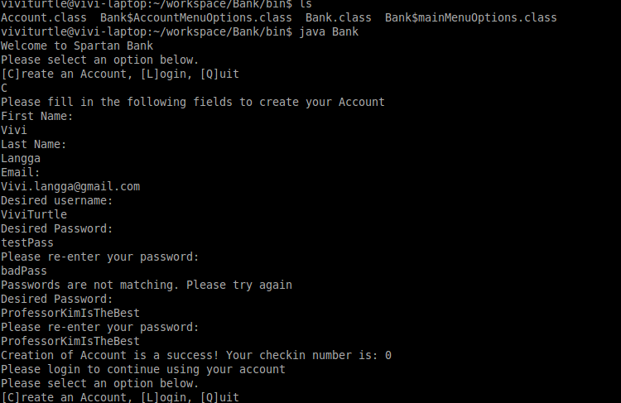
Creating an Account
Gets params
Inserts Into DB
Triggers Insert into Cash Amount with 0 cash
Triggers Insert into transanction history

Slide 12
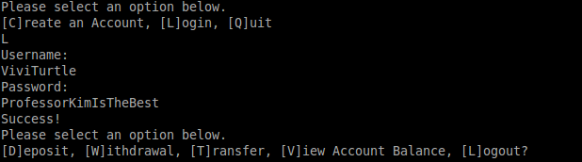
Logging In
Selects from Account Database
If empty query is empty, return use to main
If success triggers update to last_Logged_In in Account DB
Inserts into Transanction History with Login Code

Slide 13
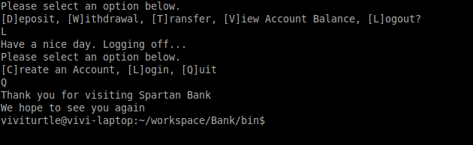
Signing Out
Returns to main Menu method
Triggers insert into transanction history with Logout code

